Slide 1
The Data Pump Utility
Jean-Jacques Porrovecchio

Slide 2
Agenda
Context
Database architecture
Data model
The packages
Files organisation
Sysper example
Requirements
Enhancements
Q&A

Slide 3
Context
Sysper2 project, 2008:
many databases: dev, test, acceptance, training, loadtest, production
several parallel streams => many schemas in each database
bi-directional dataflows with other systems: ComRef, NAP, ….

Slide 4
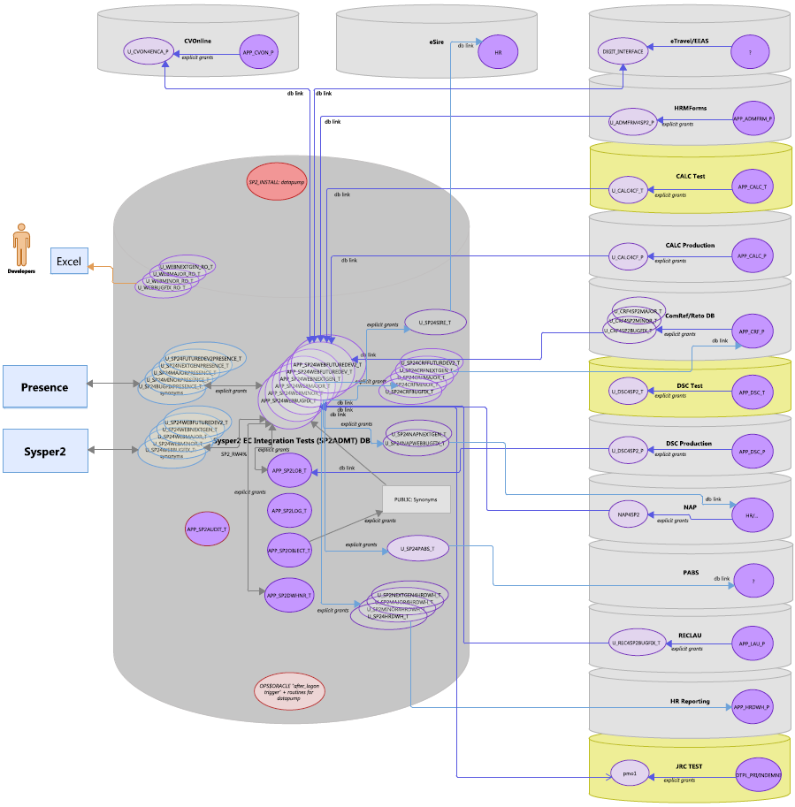
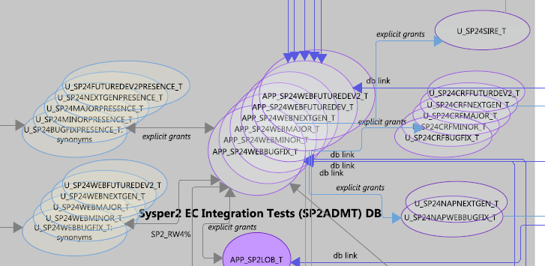
Context

Slide 5
Solution
A tool fully contained within Oracle to replicate schemas between database instances:
Export
Transfer the files (optional)
Import from files or directly via Network_Link (autumn 2019)
Pre and Post actions
Adapted for AWS Oracle RDS (spring 2020)
Adapted for Oracle 12c/19c (september 2020)
Distribution package (summer 2021)
Adapted for CoP (Cloud on Premise) (november 2022)
Used in Sysper (2009), Folio (2016), SerMed (2022)

Slide 6
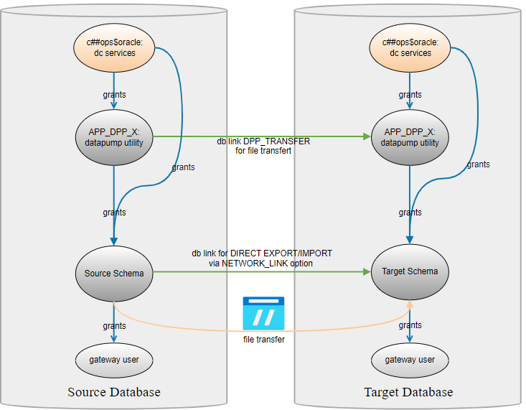
Solution architecture
On traditional Data Center Premises

Slide 7
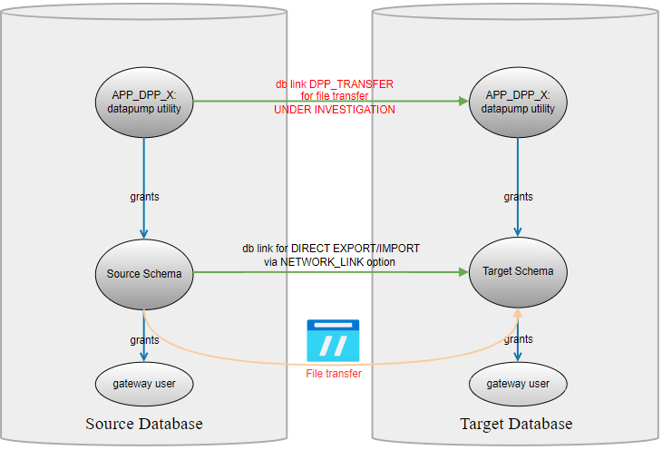
Solution architecture
In AWS Oracle RDS

Slide 8
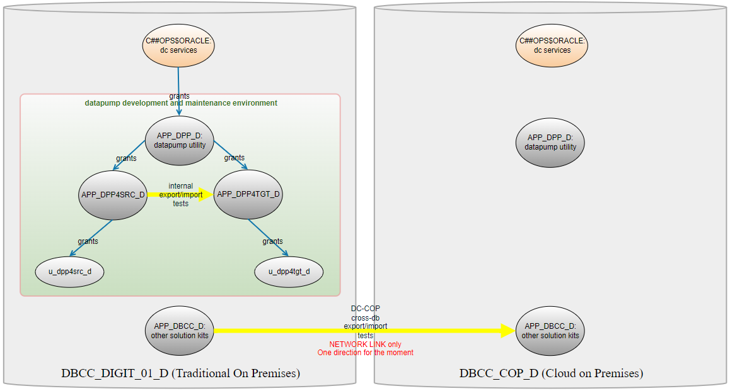
Solution architecture
Cloud on Premises (CoP)

Slide 9
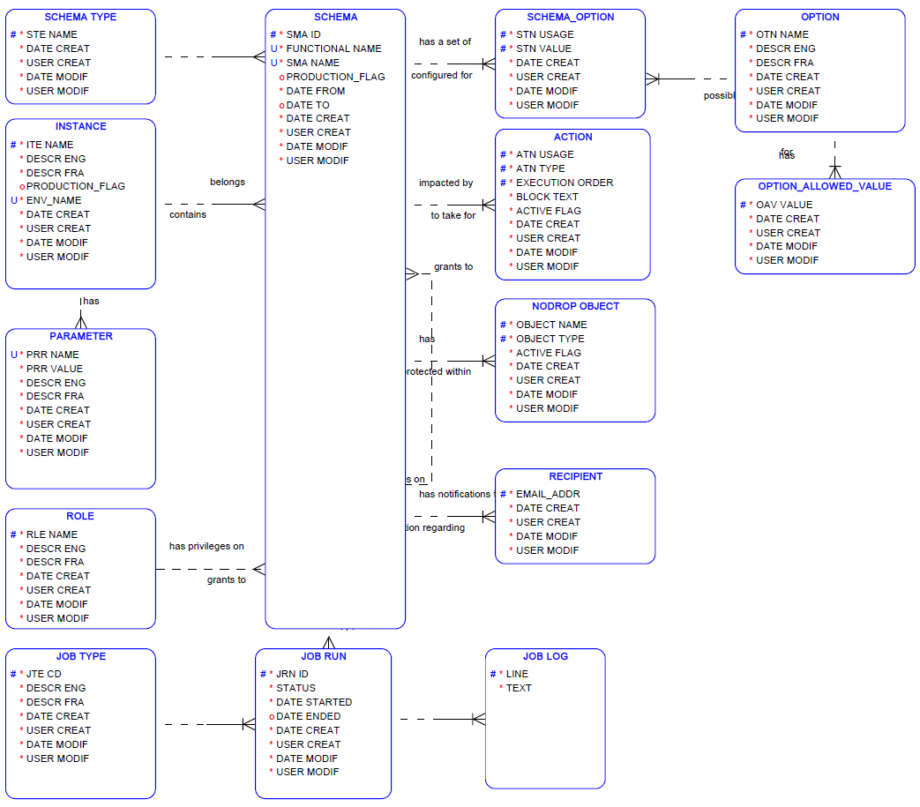
Data model

Slide 10
Data model
Instance
Development
Test
Acceptance
Production
……
Notes:
Define all the databases in which the tool will be installed for a subject application

Slide 11
Data model
Schema Type
Main
Lob
Web
Gateway for client (ComRef, ….)
….
Notes:
This typology can then be used to automate some post import actions such as restore of grants and synonyms

Slide 12
Data model
Role
ReadWrite
ReadOnly
….

Slide 13
Data model
Option
List of all available options for export, import and transfer
Notes:
Put in a single row the settings chosen for a given schema and datapump action type (export, import, transfer)

Slide 14
Data model
Option Allowed Value
List of allowed values for the options when pertinent

Slide 15
Data model
Schema Option
RECYCLEBIN=>PURGE
TABLES=>DROP
VIEWS=>DROP
EMAIL_RESULT=>YES
EXEC_POSTFIX=>YES
LOCK_SCHEMA=>YES
METADATA_FILTER=> NOT LIKE 'TMP%'
NETWORK_LINK
….

Slide 16
Data model
Action
PL/SQL code that can be invoked before or after an export or an import.
Sysper examples:
Before import: BEGIN sp2_dpp_utl.prefix_rls; END;
After import: BEGIN sp2_dpp_utl.postfix_rls; END;

Slide 17
Data model
No Drop Object
Excludes objects from being dropped if otherwise specified by the (example)
TABLE=>DROP value.
It can be a table, an index, a sequence, a materialized view, a package…

Slide 18
Data model
Job Type
Export
Import
File Transfer

Slide 19
Data model
Job Run
Contains status, start and ending date of all job runs

Slide 20
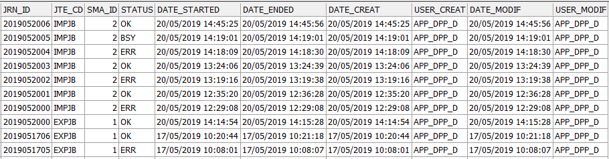
Data model
Job Run example

Slide 21
APP_DPP_x Data model
Job Run example

Slide 22
Data model
Job Log
Contains detailed job run information

Slide 23
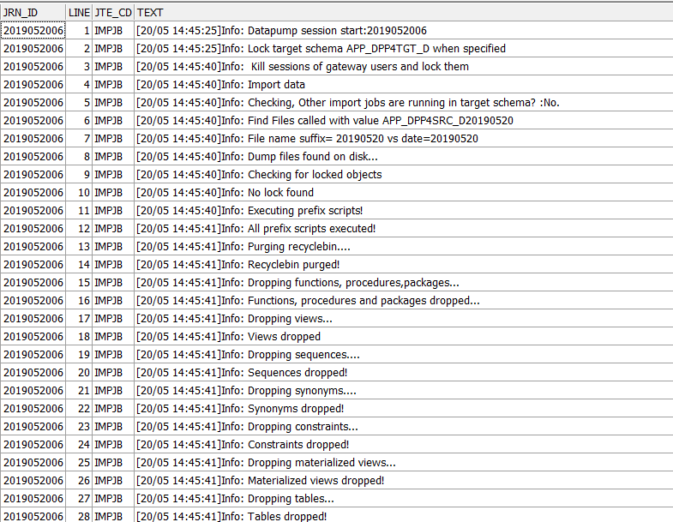
Data model
Job Log example (pre import)

Slide 24
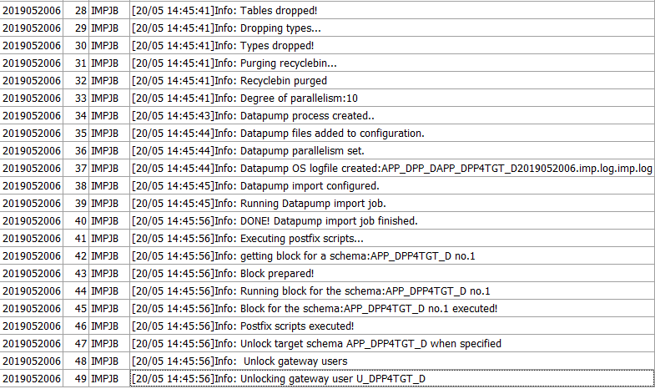
Data model
Job Log example (pre import, part 2)

Slide 25
Data model
Recipient
List of email addresses that should receive a notification when an export/import/file transfer process is performed for the related schema

Slide 26
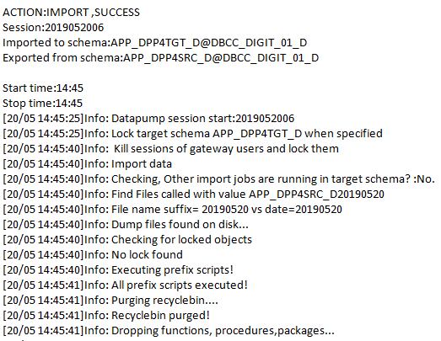
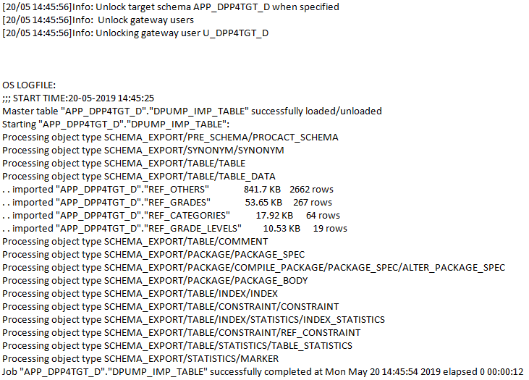
Data model
Recipient: notification example

Slide 27
Data model
Schema
Configuration of the schemas of your databases:
Instance
Type
Associated roles (eg RW for a gateway applicative user)
Linked schemas (n:n)
….

Slide 28
Data model
Configuration of the utility itself. Global or specific to given instances. So far, only a couple of global Oracle directory names

Slide 29
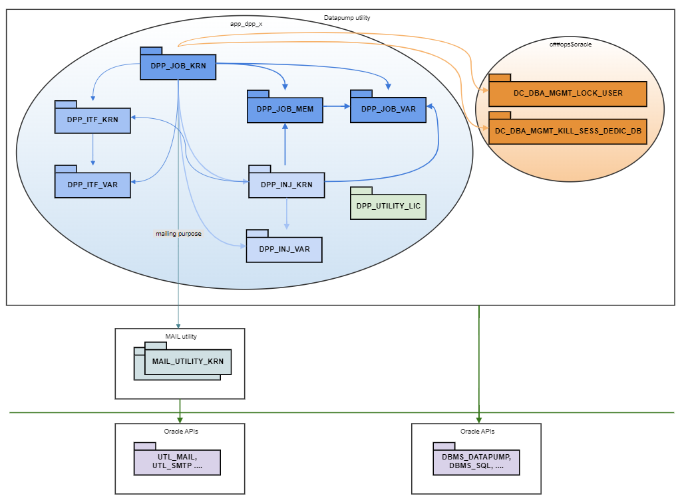
Packages
On DC premises Core engine:
DPP_JOB_KRN
DPP_JOB_MEM
DPP_JOB_VAR
Injection:
DPP_INJ_KRN
DPP_INJ_VAR
Logging:
DPP_ITF_KRN
DPP_ITF_VAR
Mailing:
MAIL_UTILITY kit

Slide 30
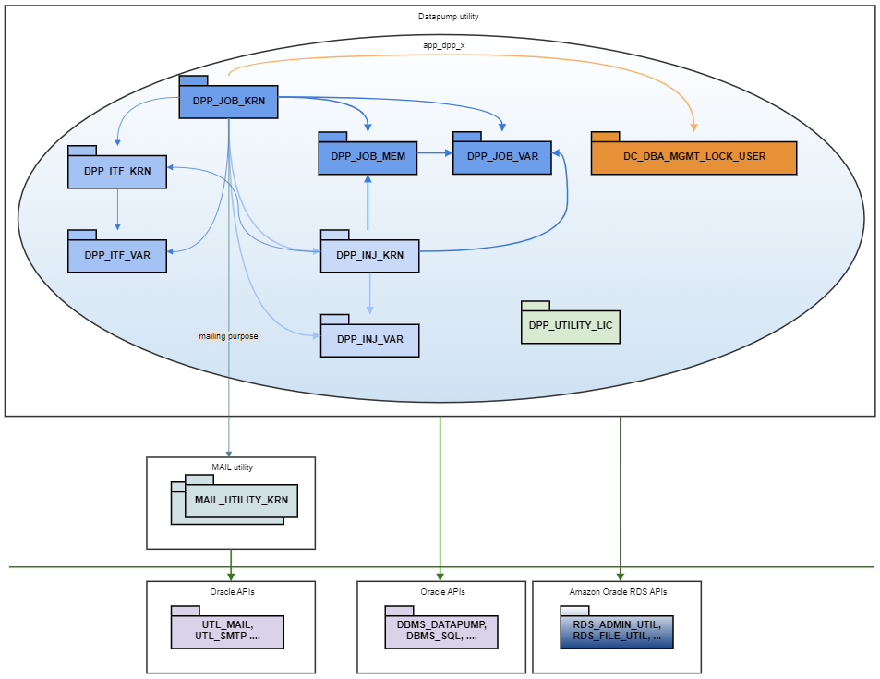
Packages
In AWS Oracle RDS

Slide 31
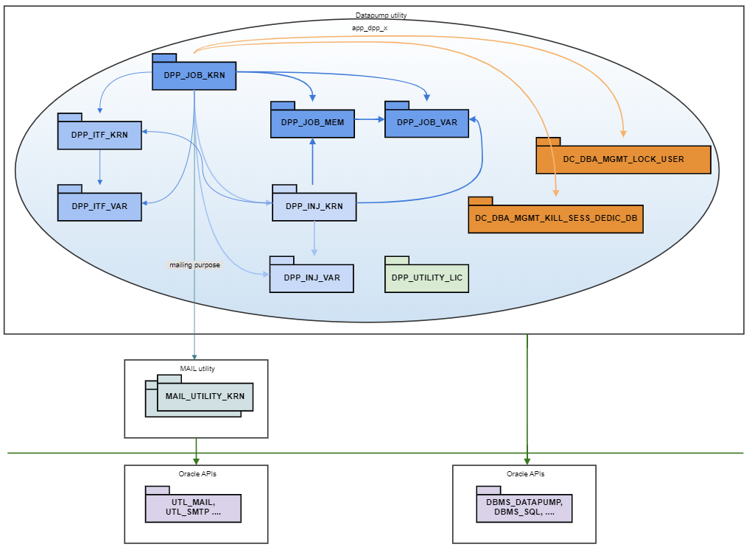
Packages
CoP (Cloud on Prem)

Slide 32
Packages
DPP_JOB_KRN Export:
Injects, runs and drops in the source schema:
Pre-export actions
export job
Sends results via email

Slide 33
Packages
DPP_JOB_KRN Import:
Locks target schema + gateway schemas
Kills sessions
Injects, runs ands drops in target schema:
pre-import actions
object drop routines
import job
post-import actions
Unlocks target schema + gateway schemas
Sends results via email

Slide 34
Packages
DPP_UTL_KRN Transfer:
Provides a service to transfer dump files between servers (DC version)
Sends results via email
DPP_INJ_KRN:
Provides all services to inject routines in a target schema and to drop them afterwards

Slide 35
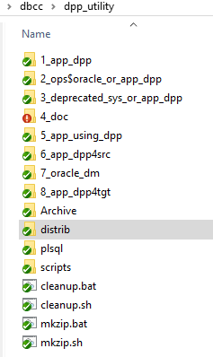
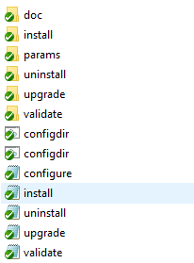
Files organization
Internal kitchen

Slide 36
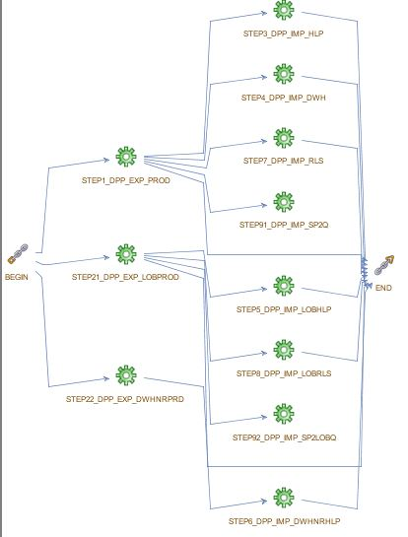
Sysper job example

Slide 37
Sysper job example
Step1_dpp_exp_prod
BEGIN
dpp_job_krn.remove_files_old_logical('PROD',SYSDATE-1);
dpp_job_krn.remove_files_old_logical@dpp_transfer('PROD',SYSDATE-1);
dpp_job_krn.export_logical_name('PROD');
dpp_job_krn.transfer_dumpfiles('PROD','dpp_transfer');
END;

Slide 38
Sysper job example
Step7_dpp_imp_rls
DECLARE
l_systimestamp VARCHAR2(20) := TO_CHAR(SYSDATE, 'YYYYMMDDHH24MISS');
BEGIN
dbms_scheduler.create_job@dpp_transfer
(job_name=>'SP2_DPP_RLSPROD_'||l_systimestamp
,job_type=>'PLSQL_BLOCK'
,job_action=> '
DECLARE
BEGIN
dpp_job_krn.import_logical_name(''PROD'',''RELEASE'');
END;
'
,start_date=> SYSTIMESTAMP, enabled=> TRUE, auto_drop=>FALSE, comments=>'COM: refresh Release schema immediately'
);
END;

Slide 39
Sysper job example
Post import action:
BEGIN sp2_dpp_utl.postfix_rls; END;
PROCEDURE postfix_rls
IS
BEGIN
postfix_common_start; -- check_prod, restore synonyms, compile and disable audit triggers, context, flags….
restore_all_grants;
sec_activation;
postfix_common_near_end(p_exists_gateway_user=>TRUE); -- enable audit triggers, web synonyms, …
-- EXTRA
create_functional_users;
END;

Slide 40
Requirements
On traditional DC premises
In AWS Oracle RDS
C##OPS$ORACLE
Objects to be installed => contact DIGIT ISHS ORACLE via EC HELPDESK IT
APP_DPP_x
System and Object privileges
Roles
Application schema
Object privileges (app_dpp_x, dictionary)
Read/Write on Oracle Directories
NAS storage
There is a standard infrastructure=> contact DC
APP_DPP_x
System and Object privileges
Roles
Application schema
Object privileges (app_dpp_x, dictionary)
Read/Write on Oracle Directories
CoP (Cloud on premises)
APP_DPP_x
System and Object privileges
Roles
Application schema
Object privileges (app_dpp_x, dictionary)
Read/Write on Oracle Directories
Notes:
No NAS for CoP for the moment

Slide 41
Enhancements
Success/Failure weak interpretation (server logs not analysed)
More flexibility regarding the METADATA_FILTER (so far only Exclude_path implemented)

Slide 42

Questions?
PL/SQL Datapump Utility

Slide 43

Thank you!
© European Union 2020
Reuse of this presentation authorised under the CC BY 4.0 license.

